Slide 1




CAVERS FOR CAVERS
50 YEARS OF UIS CAVE RESCUE COMMISSION
HEGEDŰS, Gyula
17th International Congress of Speleology
Sydney, Australia, 2017

Slide 2
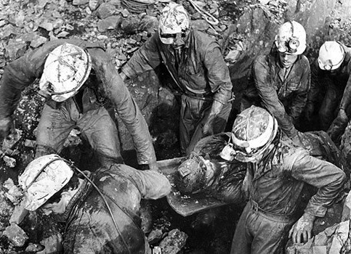
Before UIS CRC
Cave Rescue Organization in Yorkshire, the first in the world, in 1935
Mendip Rescue Organization in Somerset in 1936
Derbyshire Cave Rescue Organization
in 1952.

Slide 3

Before UIS CRC
first international meeting
Bruxelles and Han-sur-Lesse/Belgium
13-15 April, 1963
8 countries participated: England
Belgium
France
Lebanon
Luxembourg
Italy
Romania
Switzerland
Before UIS CRC
Discussed topics :
necessity for caving leaders to be ready to carry out rescues themselves
involvement of the country where a rescue operation is being conducted
recognition of legal power
search for an adaptive stretcher
post-siphon rescue problems

Slide 4
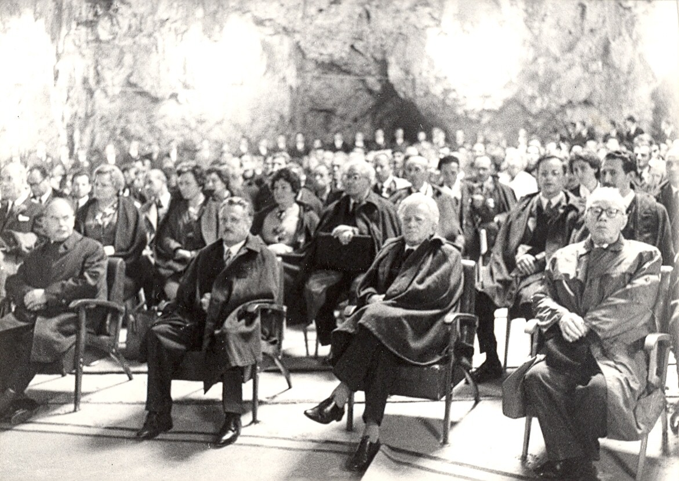
Establishment of the UIS CRC
4th International Congress of Speleology was held in Postojna/Yugoslavia in 1965
during the General Assembly 23 countries decided to establish the UIS
CRC was among the first three commissions
proposal was made by Alexis de Martynoff

Slide 5
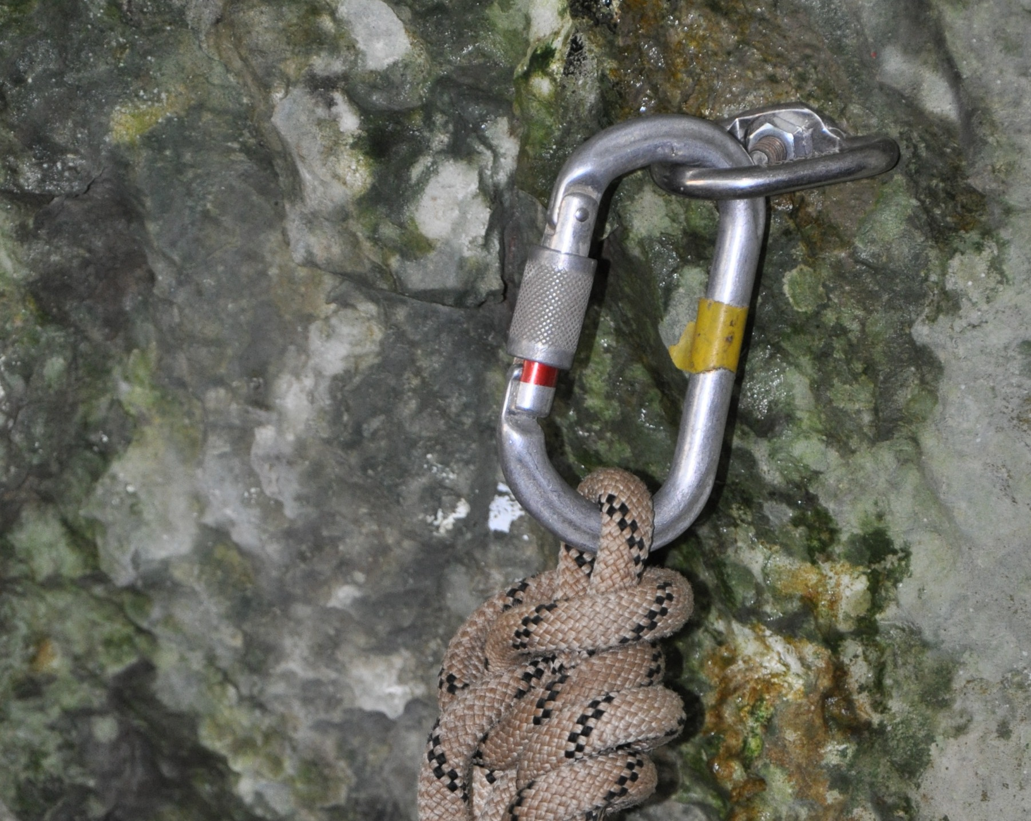
Key persons of UIS CRC
Alexis de Martynoff
Mike Meredith
André Slagmolen
Christian Dodelin
Gyorgy Denes

Slide 6
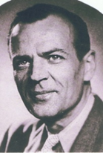
Alexis de Martynoff
(1907-1985)
born in Kharkow/USSR at 27 September 1907
died in Bruxelles/Belgium at 25 April 1985
in 1952 he founded the Belgian Cave Rescue
he was president of the UIS CRC for 16 years between 1965 and 1981
he dealt with the prevention by teaching and education

Slide 7
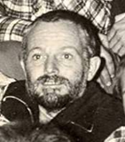
Mike Meredith
in 1981 Mike was elected as president of UIS CRC. He was in that position until 1987
his cave's career began with Burnley Caving Club
later he joined the staff of Whernside Caving Centre as Chief Instructor
living in Grenoble he became a leading light in the Furets Jaune de Seyssins caving club
later he continued his caving in Austria
after 1987 he went into Malaysia where he became Vice-Chair of Biodiversity Conservation Society Sarawak

Slide 8
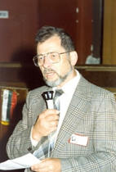
André Slagmolen
he was the secretary of the UIS CRC since 6th International Cave Rescue Conference held in Aggtelek/Hungary in 1983
he became the third president in Cividale/Italy in1987
he was one of the founder of the Belgian Cave Rescue in 1952
he died in 22 April 2007

Slide 9
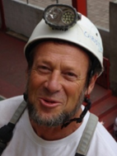
Christian Dodelin
he fill the position as president of UIS CRC since Athens/Kalamos (Greece)/2005
he is caver since 1970
instructor at the French Caving School
he joined to French Cave Rescue (Spéléo Secours Français – SSF) in 1982
participated of more than fifty rescue operations
he was president of SSF from 1996 to 2004
leader of international cave rescue training since 1997

Slide 10
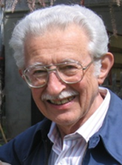
Gyorgy Denes
(1923-2015)
he was elected as secretary general of the UIS CRC in Zakopane/Poland in 1979
as vice president in Aggtelek/Hungary in 1983
as honorary president in Aggtelek-Jósvafő/Hungary 2007
he participated in reorganization of HSS in 1958, where he became secretary, secretary general and finally honorary president
he established the HCRS in 1961

Slide 11
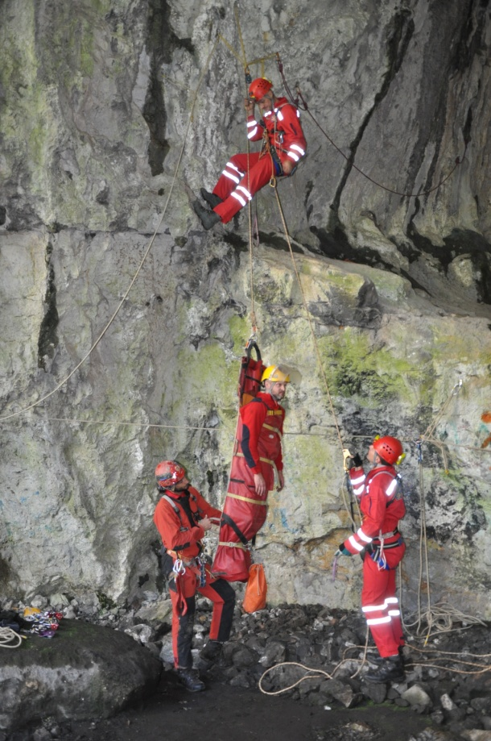
Events of UIS CRC
Mozet/Belgium 1971
Eisriesenwelt/Austria 1975
Sheffield/Great-Britain 1977
Zakopane/Poland 1979
Aggtelek/Hungary 1983
Cividale/Italy 1987
Budapest/Hungary 1989
La Chaux-de-Fondes/Switzerland 1997
Sart-Tilman/Belgium 2002
Athens-Kalamos/Greece 2005
Aggtelek-Jósvafő/Hungary 2007
Dryanovo/Bulgaria 2011
Brno/Czech Republic 2013
Vaumarcus/Switzerland 2015

Slide 12
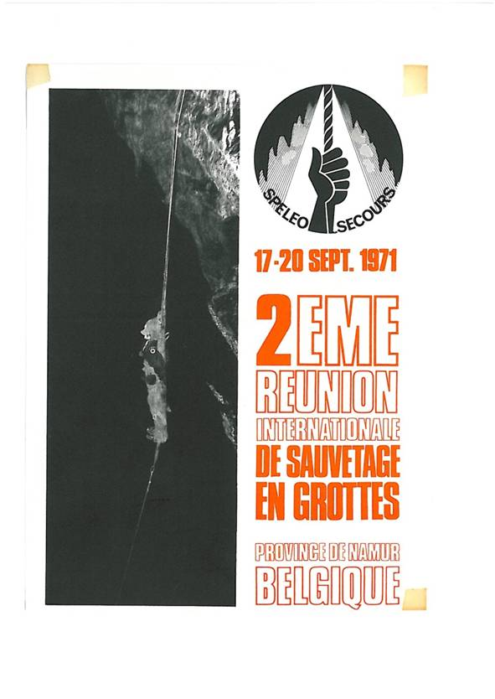
Mozet/Belgium
17-21 September, 1971
16 countries participated
  Germany, England, Belgium, Bulgaria, Congo, Denmark, Spain, France, Greece, Hungary, Italy, Lebanon, New Zealand, Poland, Switzerland, Yugoslavia
Program
  presentation of the first cave stretcher, demonstration of caving radio communication, diving rescue, legal problems, responsibilities and insurance policies
Decided such an international meeting should be organized every four years

Slide 13

Eisriesenwelt/Austria 1975
12 countries participated
  Austria, Belgium, England, France, Germany, Greece, Hungary, Italy, Poland, Spain, Switzerland and Yugoslavia
Program
  create Sub-Commission to develop a catalogue of safety materials developed for use in rescue work
  demonstration with more than 9 stretchers and others ways to move injured people
  first demonstration of removing obstructions in caves
  first meeting of cave doctors

Slide 14
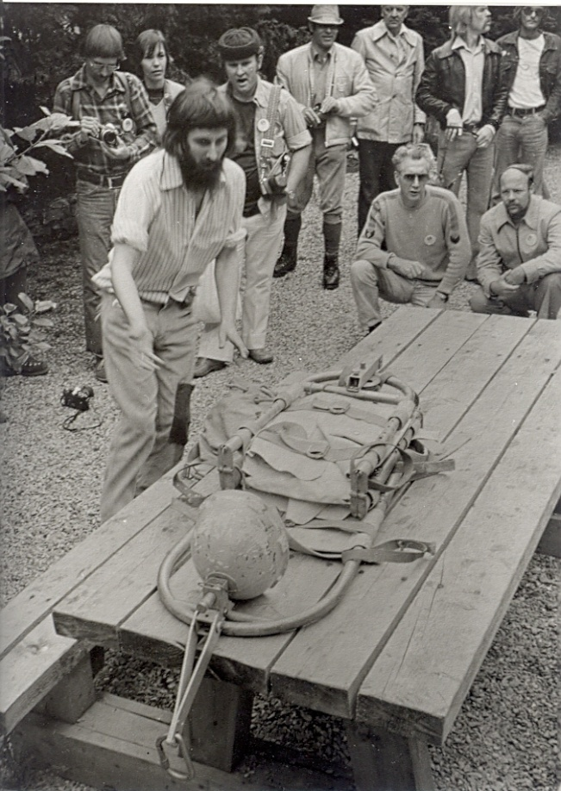
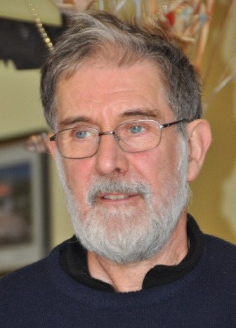
Sheffield/Great-Britain
10-17 September, 1977
17 countries informed UIS CRC that they have cave rescue services
using 10 years of experiences the NCRC (USA) and UIS CRC developed a scoring system which would act as a measure of overall technical or the gross ability of a rescue service
the system count with
  emergency medical skills
  training
  team size
  special skills
  organization
  mobilization
  equipments as for
    communication and vertical caving,
    extraction and patient transportation tools
1977
2016

Slide 15
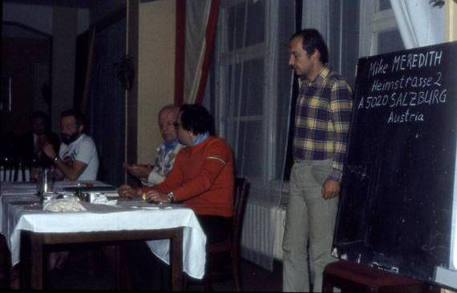
Zakopane/Poland
2-6 October, 1979
14 countries participated
  Austria, Belgium, Bulgaria, Czechoslovakia, France, Germany, Great-Britain, Hungary, Italy, Portugal, USSR, Spain, United-States and Yugoslavia
During this 5th international conference it was decided to form a bigger direction and to create three subcommissions
president : Alexis de Martinoff (Belgium)
vice-president (American area) : Daniel. Smith (USA)
vice-president (East europe area) : A. Efremov (URSS)
vice-president (West europe area) : Giuseppe Guidi (Italy)
secretary-general : György Denes (Hungary)
prevention : Petko Nedkov (Bulgaria)
material : Hermann Kirchmayr (Austria)
technique : Mike Meredith (Great-Britain)

Slide 16
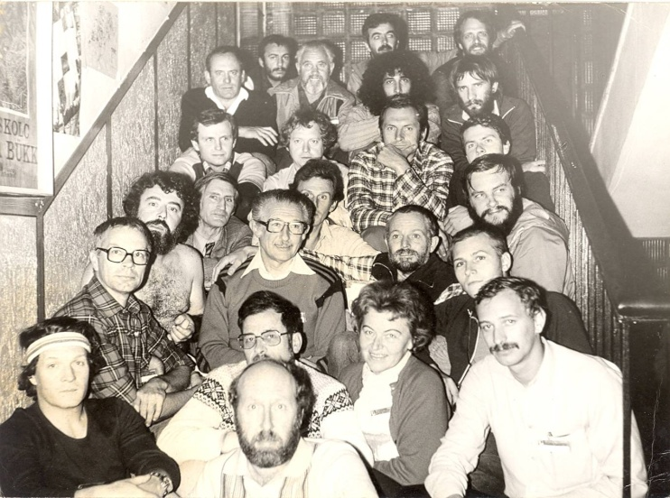
Aggtelek/Hungary
2-8 October, 1983
More than 160 participants from 16 countries
  Austria, Belgium, Bulgaria, Czechoslovakia, France, Germany, Great-Britain, Hungary, Italy, Portugal, Romania, United-States, USSR, Spain, Switzerland and Yugoslavia
50 lectures were given about
  cave-rescue equipements
  communication equipements
  methodology
  first aid and other medical aspects
  rescuers training
  statistics on causes of accidents
  organisation background
  prevention of accidents and
  experiences of rescue operations.
Rescue demonstrations were performed by
  Hungarian, Austrian, Russian, French and Italian rescue teams

Slide 17
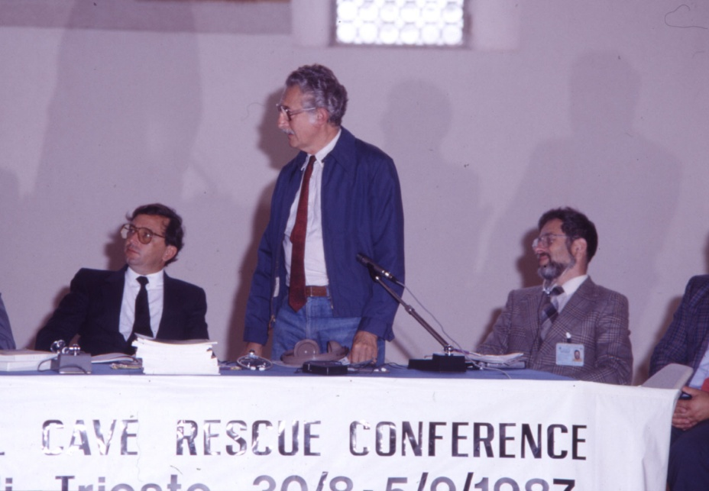
Cividale/Italy
30 Aug.-5 Sept., 1987
16 countries participated
  Austria, Argentina, Belgium, Czechoslovakia, Dominican Republic, France, Germany, Great-Britain, Greece, Hungary, Italy, Romania, Spain, Switzerland, USA and Yugoslavia
Program included:
9 medical presentation about pharmacy, medical actions, the administration of drugs and histoplasmosis
12 technical presentations about various stretchers, cave-diving rescue, drilling material and the UIS catalog of materials
18 presentations in prevention section about statistics of rescue operations and circulation of informations

Slide 18
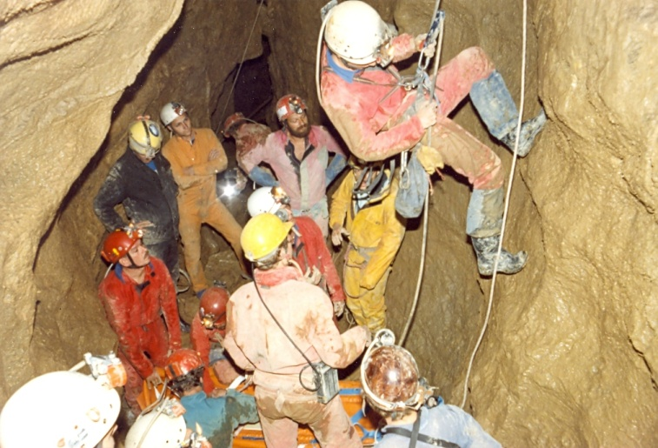
Budapest/Hungary
9-13 August, 1989
143 participants had arrived from 21 countries:
  Australia, Austria, Belgium, Bulgaria, Canada, Czechoslovakia, France, Germany, Great-Britain, Greece, Hungary, Italy, Norway, Poland, Romania, Spain, Switzerland, Sweden, USSR, Venezuela and Yugoslavia
13 lecturer presented 18 presentations
15 practical demonstrations
12 medical doctors sat around a table from 7 countries
a common cave rescue exercise was also organized

Slide 19
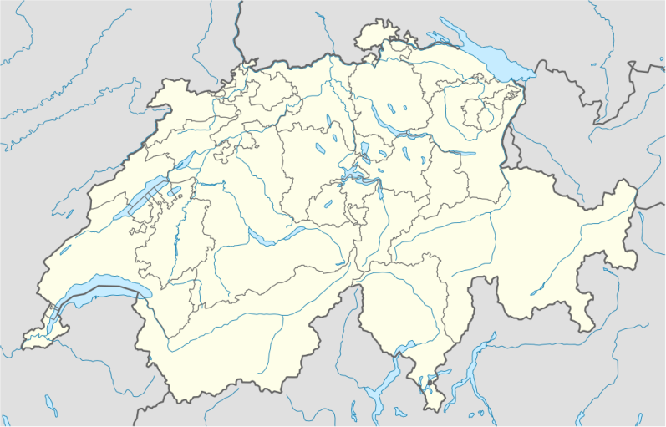
La Chaux-de-Fondes/Switzerland
10-17 August 1997
event was organized as part of the 12th ICS
La Chaux-de-Fondes
presentations dealt with:
cave accidents in France,
cave rescue in Switzerland
histoplasmosis
waterproof stretcher for divers rescue
victim's assistance and epidemic dangers in the caves of Middle Asia
Efrain Mercado was named as regional coordinator for the FEALC

Slide 20

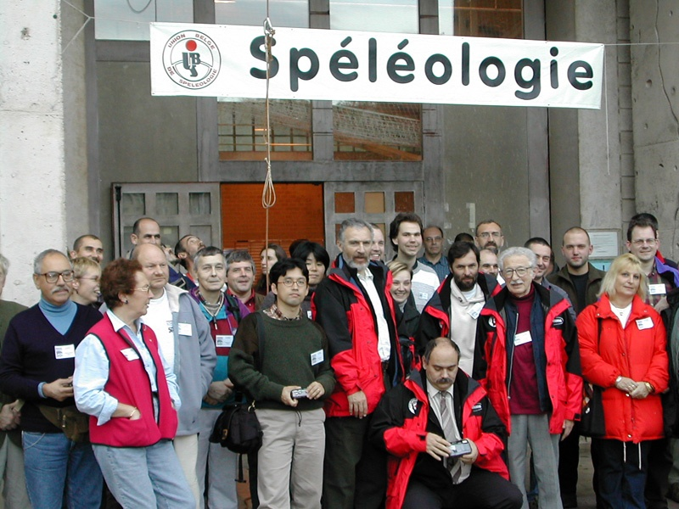
Sart-Tilman/Belgium
1-3 November, 2002
organized on the occasion of the 50th anniversary of the Belgian Cave Rescue
117 participants from 14 countries:
  Austria, Belgium, Corea, Cuba, France, Germany, Great-Britain, Hungary, Japan, Luxembourg, Morocco, Poland, Switzerland, USA
40 lectures were presented on the next topics:
cost of cave rescue operations and interest of a cave rescue team
presentation of some rescue operations
medical presentations, histoplasmosis
passage widening with Hilti cartridge
cave ventillation
round table with international interventions as subject

Slide 21
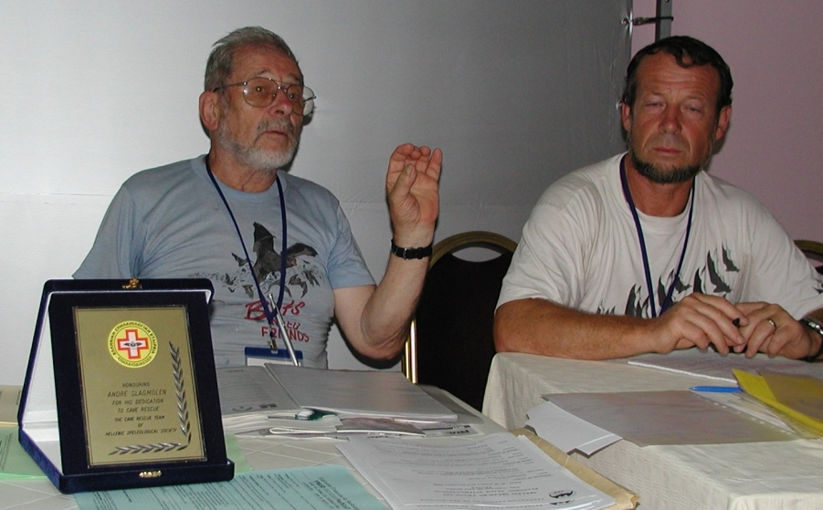
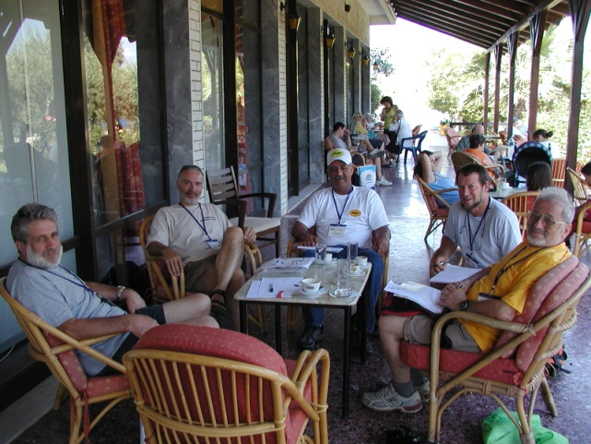
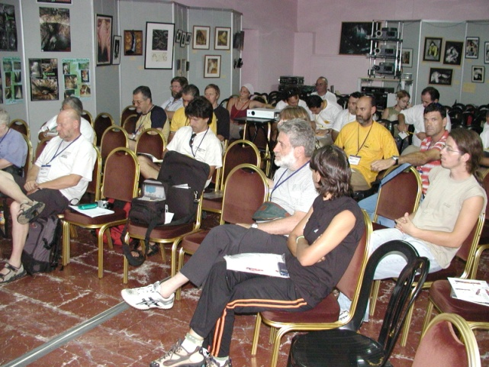
Athens-Kalamos/Greece
21-28 August, 2005
on the occasion of the 14th ICS
André Slagmolen retired as president of UIS CRC
Christian Dodelin was elected as new president
main topic was cave rescuers education

Slide 22
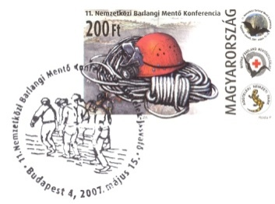
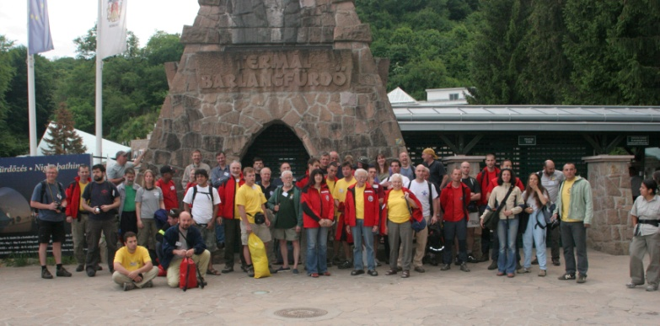
Aggtelek-Jósvafő/Hungary
15-18 May, 2007
83 participants from 26 countries:
  Austria, Belgium, Bosnia-Hercegovina, Bulgaria, Croatia, Spain, France, Germany, Great-Britain, Greece, Hungary, Italy, Japan, Lebanon, Mexico, Montenegro, Norway, Poland, Puerto Rico, Czech Republic, Romania, Serbia, Slovakia, Slovenia, Sweden, USA
38 papers and video reports and demonstration were presented about next main topics:
                organizational aspects of cave rescue
                contributions of cave rescue squad for civil protection during disaster
                medical aspects of cave rescue activity
                cave rescue educations and trainings
                equipments, technics and radio transmission demo
                serious rescue operations in different countries
Aggtelek Agreement were created!

Slide 23
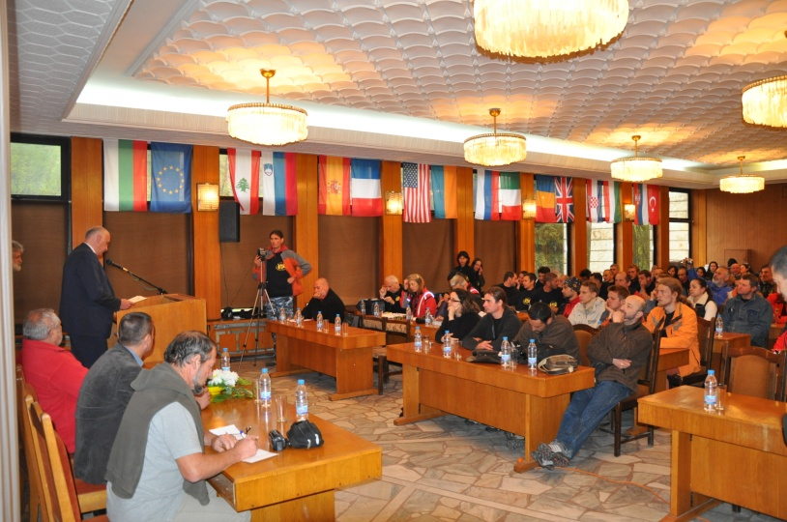
Dryanovo/Bulgaria
8-15 May, 2011
100 cavers participated from 15 countries:
  Bulgaria, Croatia, France, Great-Britain, Hungary, Italy, Lebanon, Puerto Rico, Romania, Russia, Serbia, Slovenia, Spain, Ukraine and USA
24 papers and 2 demonstrations
  new rescue techniques on rock wall
  new rescue techniques in cave
  equipment presentations
  new rope techniques demonstrations
  medical demonstration
  diving demonstration
  new diving equipment for rescue
  communication in caves
  "sit harness syndrome"
  work-related hypothermia
  usefulness of cooperation
  Italians presented their activity at an earthquake

Slide 24
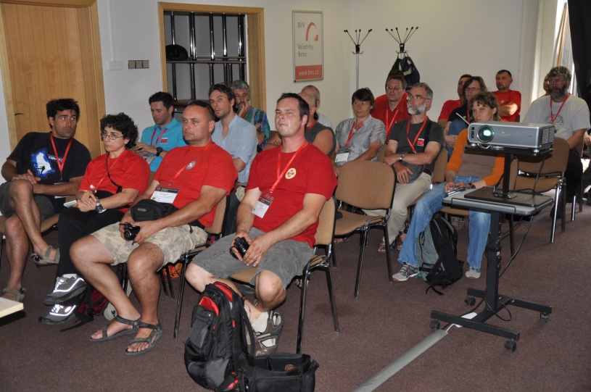
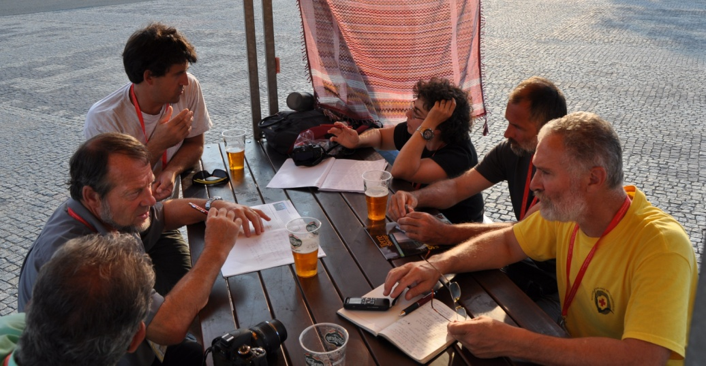
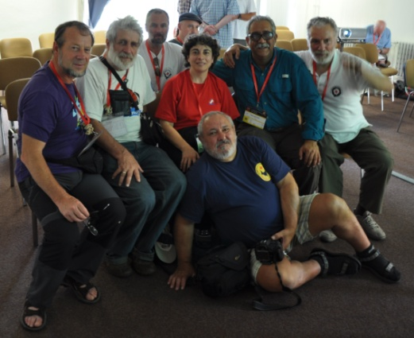
Brno/Czech Republic
21-28 July, 2013
on the occasion of the 16th ICS
2 session meetings
reviewed the activities of the past 4 years
  events
  technical developments
  trainings and educations
defined the tasks ahead

Slide 25
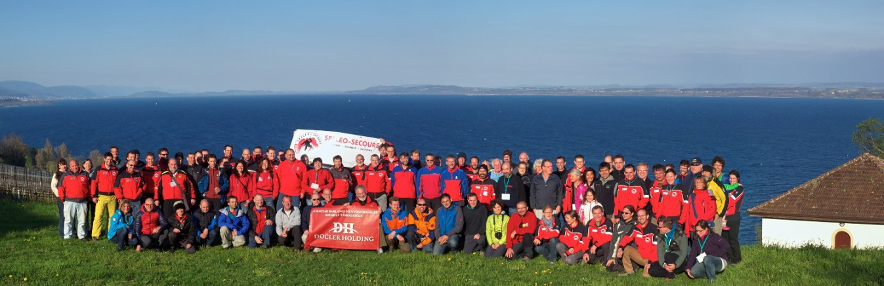
Vaumarcus/Switzerland
13-19 April, 2015
110 cavers from 14 countries:
  Austria, Belgium, Bulgaria, Canada, Croatia, France, Germany, Hungary, Italy, Netherlands, New Zealand, Russia, Slovenia and Switzerland
32 presentations about
  equipments tests
  introduction of
    cave rescue services of different countries
    European Cave Rescue Association (ECRA)
    EU Civil Protection Mechanism
  medical session diving rescue
  prevention and training
  emergency medical assistance by air

Slide 26
Sydney/Australia
23-29 July, 2017
  ...../..... 2019
  ...../..... 2021
    ...../..... 2023
          ...../..... 2025
    towards next 50 years

Slide 27
